Slide 1

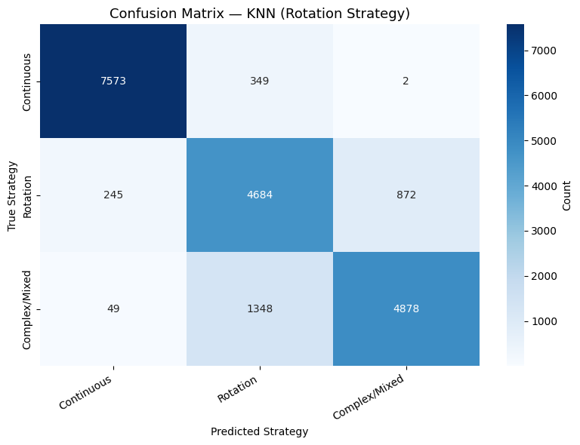
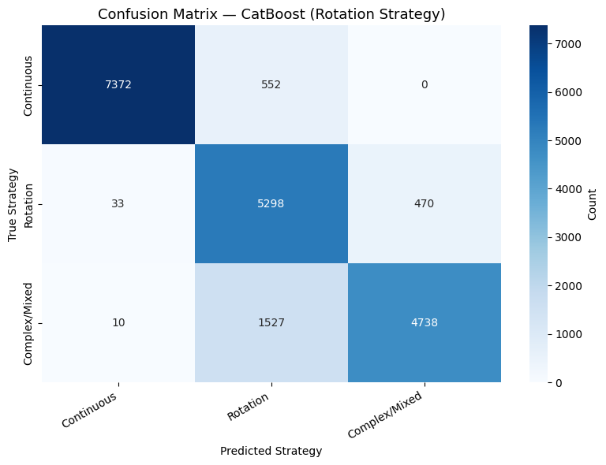
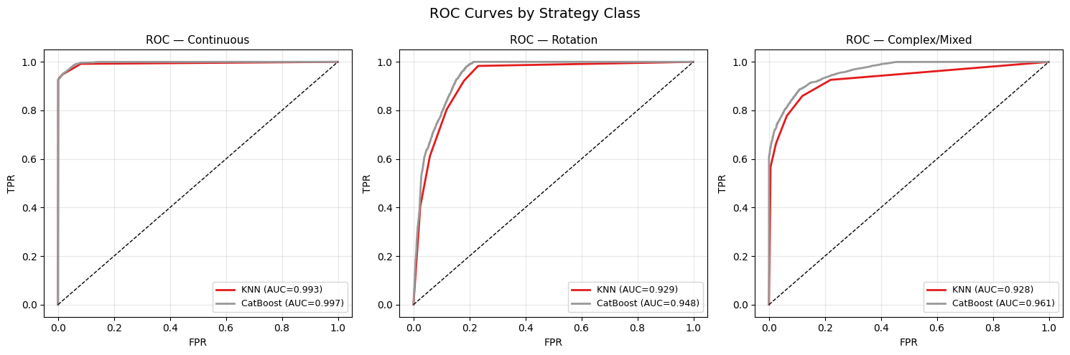
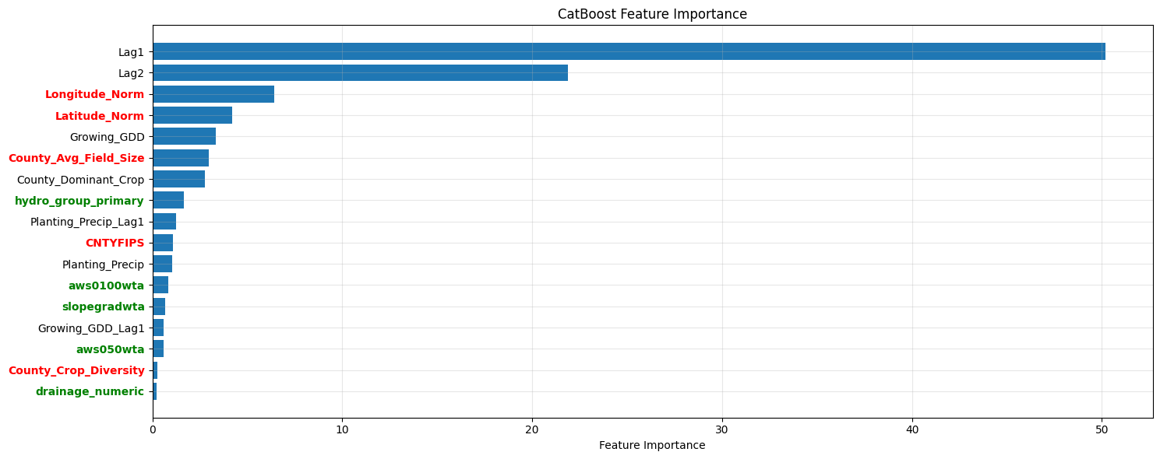
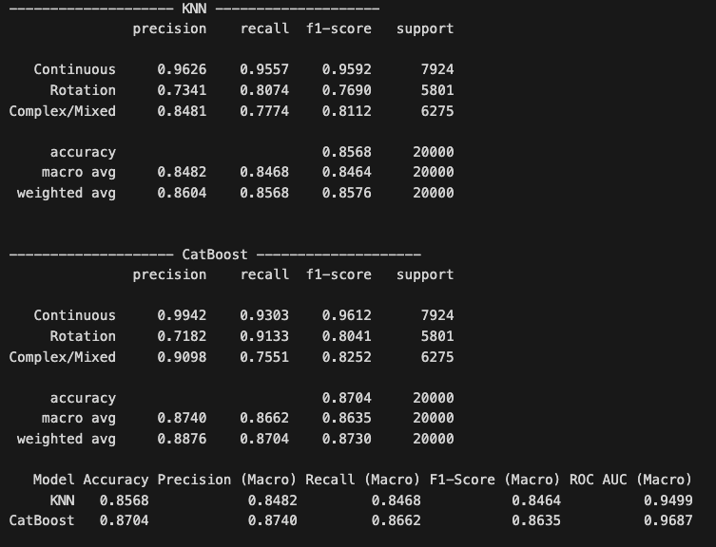
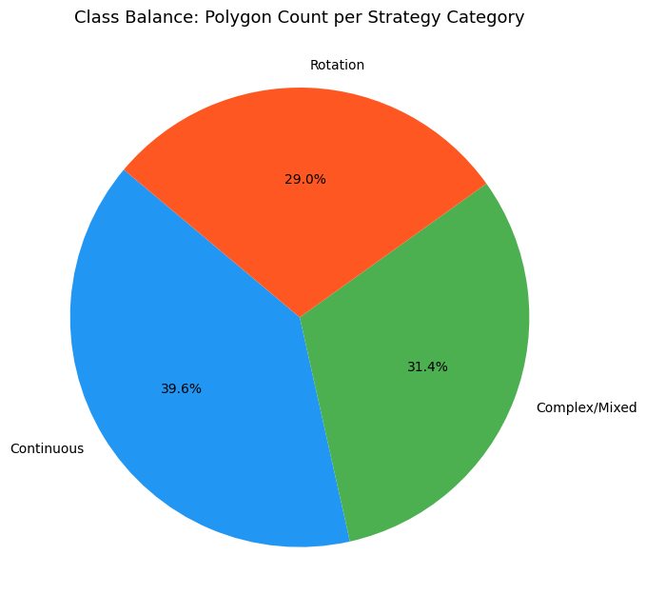
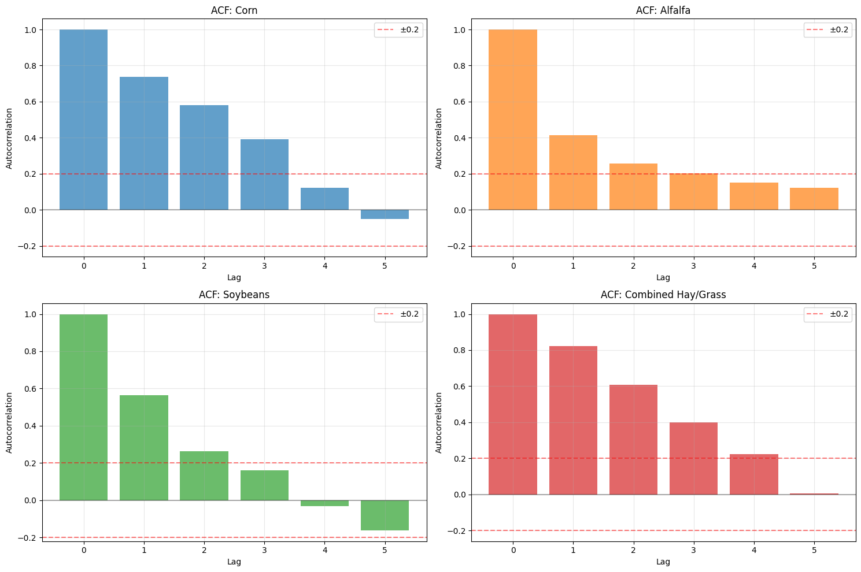
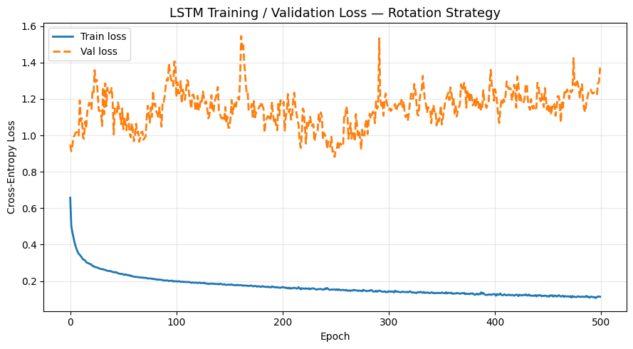
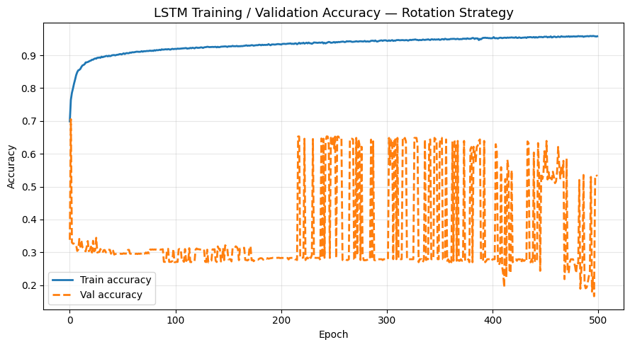
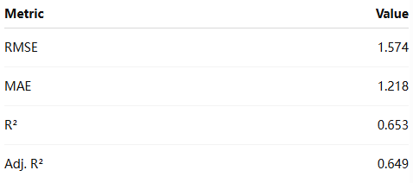
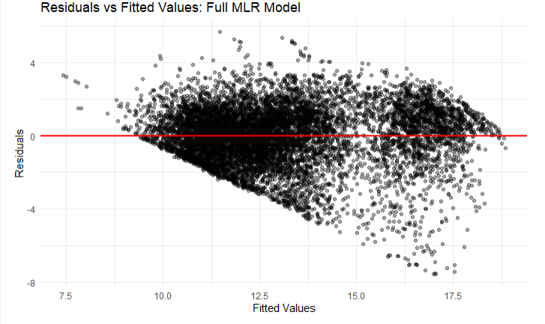
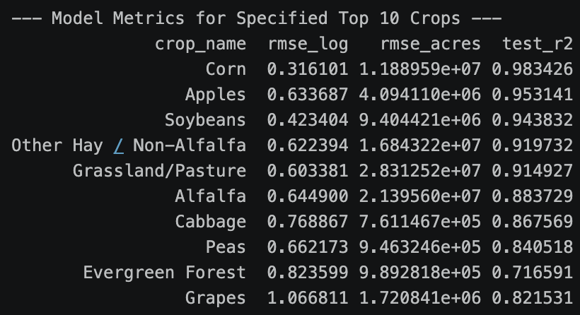
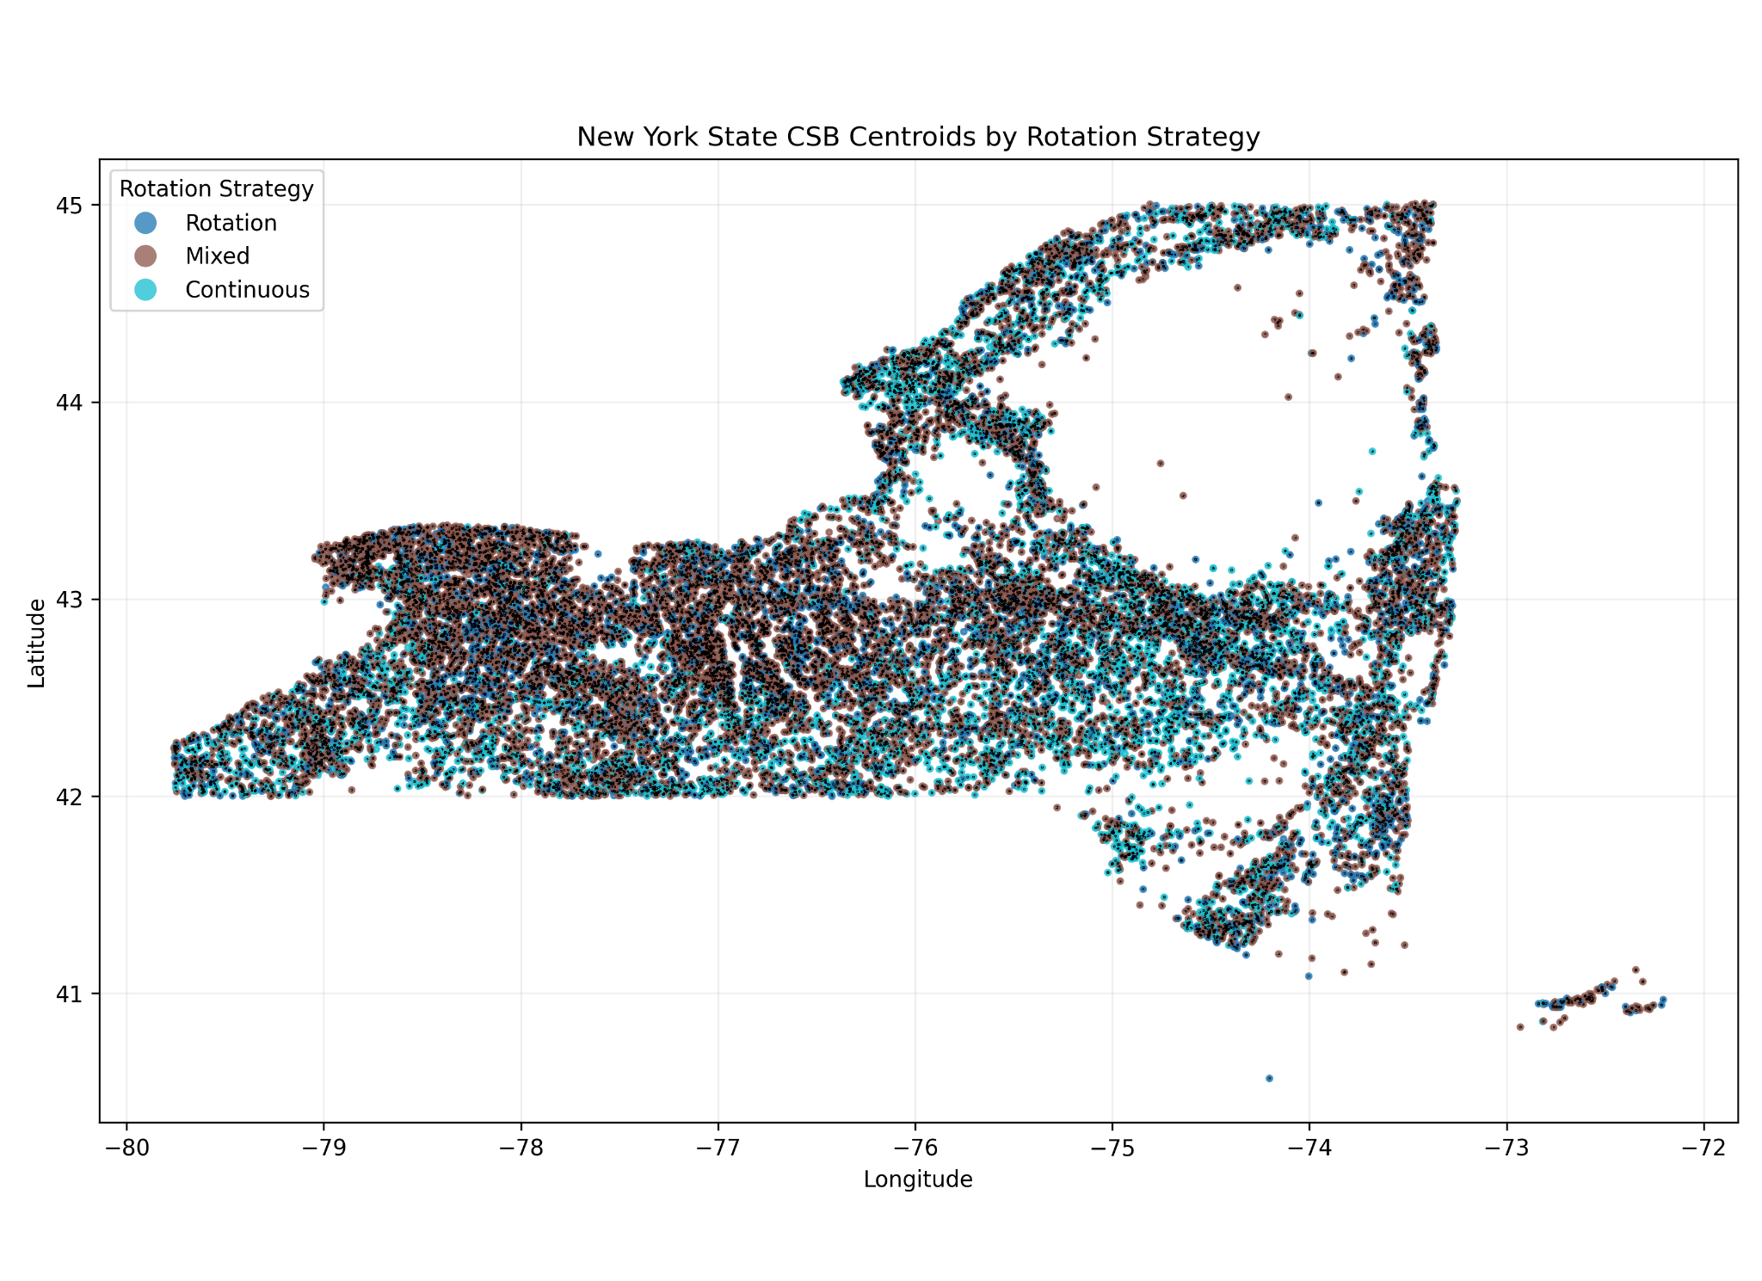
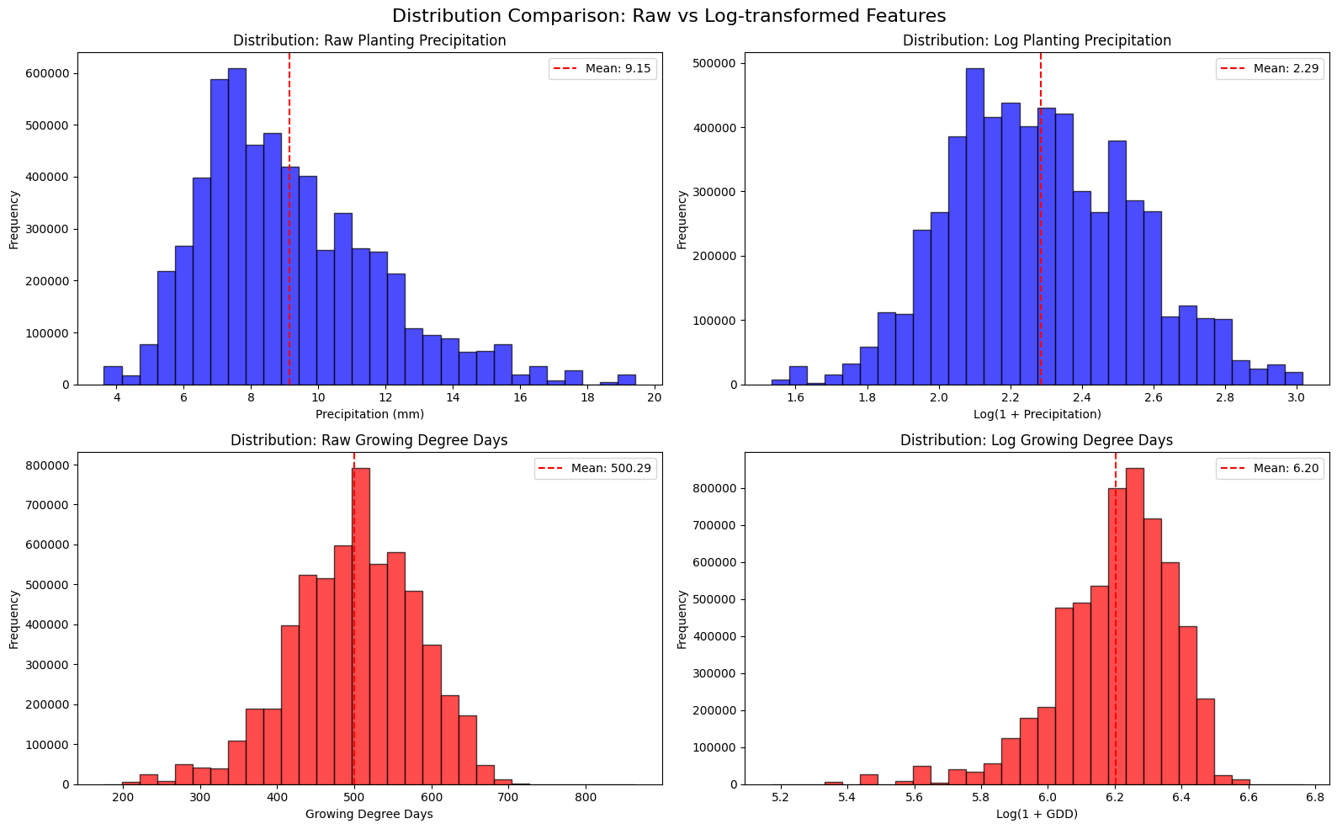
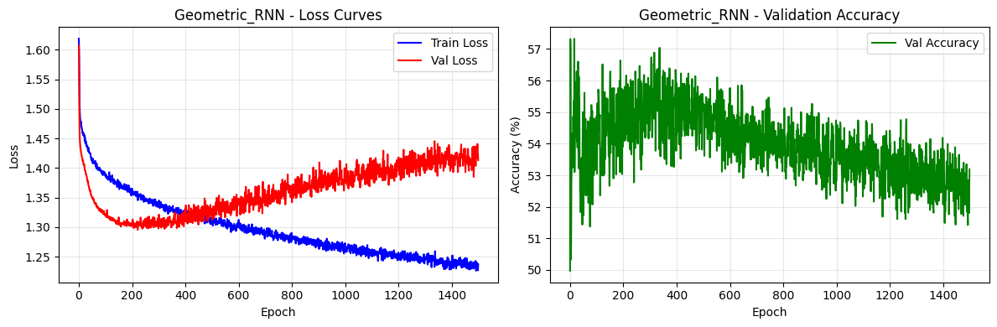
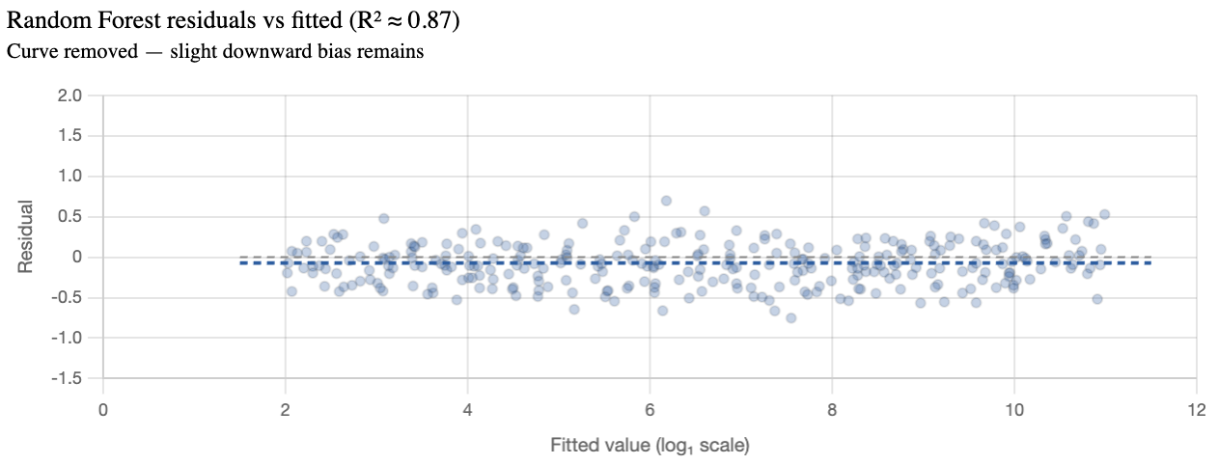
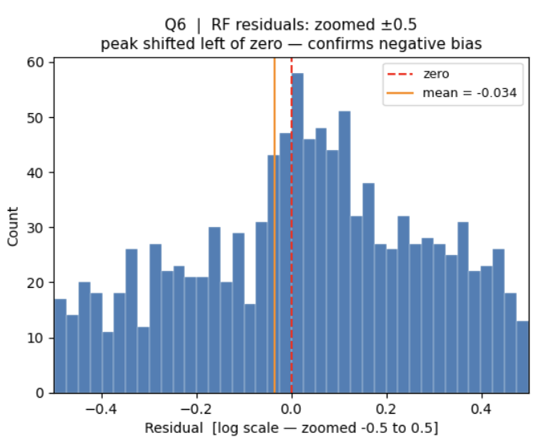
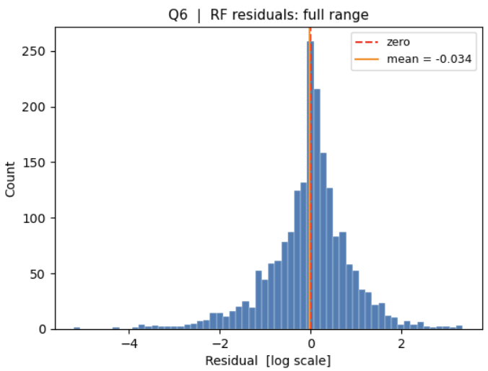
Acreage Estimation and Uncertainty Quantification for New York State
By Tony Yik-Hau Au (ya293), Wenlin Huang (wh539), Sirui Cao (sc3554), Yuheng Shen (ys2393), Yiyou Jin (yj583)
MPS in Applied Statistics and Data Science Capstone Project
Introduction & Objective
Methodology
Result
Conclusion
Forecasting crop acreage is essential for agricultural management and policy design, helping to ensure food security and optimize resources. Reliable acreage forecasts inform supply projections, guide infrastructure planning and support food security initiatives. However, planting strategies are influenced by complex interactions among economic conditions, environmental factors and historical crop rotation practices, making accurate prediction challenging.
This project applies statistical methods to model and predict future crop acreage in New York State using historical agricultural and environmental data, and compares the performance of multiple predictive models. By improving prediction accuracy and identifying key drivers of acreage decisions, this project aims to provide insights for both farmers and policymakers.
We first train a geometric classification model to generate polygon level label and apply feature selection, the label is then added as a covariate for the final regression model.
CatBoost: beats KNN baseline across the board
This project demonstrates that agricultural field classification and acreage estimation across New York State can be effectively achieved through a multi-stage feature engineering pipeline and machine learning model integrating crop sequence history, weather dynamics, soil attributes, and spatial geometry. The key insight is that agriculture is highly autocorrelated and dependent to environmental similarities.
For crop plant strategy prediction, CatBoost achieved the best tabular performance, outperforming deep learning models constrained by sample size and feature space structure. Where the bidirectional LSTM achieved slight improvement (91.92% accuracy), but we have chosen Catboost in the trade-off for interpretability at the cost of slight prediction improvement.
The full MLR baseline explains ~65% of variation in log-transformed crop acreage, while Random Forest regression further improved prediction accuracy (up to 98%), confirming that soil, weather, and rotation features carry meaningful predictive signal for acreage forecasting, while residual patterns motivate further nonlinear modeling.
Continuous: recall (~93.03% vs ~95.57%); F1 (~96.12% vs ~95.92%)
Rotation: recall (~91.33% vs ~80.74%); F1 (~80.41% vs ~76.90%)
Complex/Mixed: recall (~75.51% vs ~77.74%); F1 (~82.52% vs ~81.12%)
Planting Strategy Classification
We selected CatBoosting for its robust accuracy (vs KNN) and training efficiency (vs LSTM), the model’s built-in feature importance served as the feature selection for later model.
Iterations: 100; LN rate: 0.01
Max Depth: 4
Out: pred. prob. (softmax)
Most important Feature: lagged strategy & spatial label (by observing prediction values change)
vs XGBoost: Avoid one-hot coding => memory efficient
Data Pipeline & Feature Engineering
CSB (Crop Sequence Boundaries): A satellite-derived dataset providing non-confidential, field-level crop rotations, boundaries, and acreage across the contiguous U.S. from 2008 to 2024 with geometric label from USDA. The polygon data is grouped and merged in a wide format. (1,553,005 polygons)
Weather Data: a panel of county-level weekly weather observations, containing detailed temperature, precipitation, growing degree days, and aridity measures along with their deviations from historical norms and prior periods.
Soil Data: USDA gSSURGO provides detailed soil properties, including slope, water table depth, water storage capacity, bedrock depth, and ponding frequency. Soil polygons were aggregated to the county level using spatial joins and weighted averages to align with CSB data.
Data Exploration & Transformation
(Macro Summary Metric)
accuracy (87.0% vs 85.7%)
precision (87.40% vs 84.82%)
recall (86.62% vs 84.68%)
F1 (86.35% vs 84.64%)
ROC AUC (96.87% vs 94.99%)
Area for Improvement
While the current pipeline yields strong results, several directions remain for future enhancement:
Measurement error: The CSB data is annual data, which smoothed out the monthly pattern and seasonality of the signal from the environmental data.
Adding satellite imagery (e.g. Vegetation Index) and field-level weather/soil data would provide more precise signals beyond county-level aggregates.
Formal conformal prediction or Bayesian approaches should be applied to produce calibrated confidence intervals on both classification and acreage outputs.
Crop type: Exploring Transformer-based or graph-based models may better capture long-range crop patterns and spatial relationships between neighboring fields. The currently CNN/RNN model struggle to predict crop type.
Deep learning models were trained on only 50K samples due to computational constraints; scaling to the full 5.9M-record dataset may significantly expand the performance gap with CatBoost.
Random Forest models were trained independently per crop type; a unified multi-output model or ensemble approach could better capture cross-crop dependencies and improve generalization.
Baseline Modeling: Full MLR
To establish an interpretable baseline, we fitted a full multiple linear regression model to predict log-transformed crop acreage:
log(1 + acreage_area_proxy)
Predictors included crop type, year, soil characteristics, weather variables, and crop rotation features in county-level.
The full MLR model explains about 65% of the variation in log acreage, with a log-scale RMSE of 1.57. After back-transforming predictions to the original acreage scale, the MSE was 1.24 × 10¹⁵. This value is very large because acreage values are large in the original scale, and MSE squares the prediction errors. Overall, the model is informative as a baseline, but residual patterns suggest that more flexible models are needed to capture nonlinear relationships.
(LSTM)
Hidden layer = 2
# Epoch: 500
Batch size: 64
Optimizer: Adam
Loss: Entropy
Split (classification): 2008-22 training set; 2023-24 validation set
We noted the LSTM model struggled to generalize the strategy, the validation accuracy is fluctuating around 65% ~ 20%.
To simplify modeling, we grouped the 200+ crop into 5 types: Corn, Soybeans, Alfalfa, Hay/Grass, others; and 3 rotational strategies: Rotation, Mixed, Continuous. The data are balanced on the polygon level, which solved the imbalance issue on acreage level.
Random Forest: high predictive accuracy & low uncertainty
The top models achieve test R-squared between 0.82 and 0.98; The full residual histogram appears nearly symmetric, zooming to ±0.5 exposes a peak left of zero, indicating slight over-prediction systematically.
Random Forest Regression
Separate RandomForestRegressor (100 trees) trained per crop on log(1 + acreage); 80/20 train-test split.
RF residuals are randomly scattered (pooled R² = 0.87), confirming the flexible model removes this structure — though a slight negative bias (mean ≈ −0.07) persists.
Data exhibited forecastability in spatial clustering (Longitude & Latitude ) and stationarity (Autocorrelation).
Acknowledgement
The soil variables we used are average land slope, the minimum depth to bedrock, the annual minimum depth to the water table, the minimum water table depth from April to June , ponding frequency and available water storage in the upper 50 cm and 100 cm of soil. These soil variables were standardized using scaling.
(Deep learning model struggle to learn crop prediction)
Luca Sartore, Ph.D., NISS Contractor (Senior Research Fellow), U.S. Department of Agriculture
David Ruppert, Ph.D., Andrew Schultz Jr. Professor of Engineering and Professor of Statistics and Data Science at Cornell University

